Slide 1
Systems

Slide 2
Objectives
We will look at some services that are provided to make a network operate
DHCP– dynamic host configuration protocol servers
To automatically allocate IP addresses to hosts
DNS - domain name servers
To translate web addresses (and other things) to actual IP addresses of the corresponding web servers

Slide 3
DHCP
Why use DHCP
Automation of configuring IP addresses
Laptops are dynamic and hence need to take on different IP addresses
Need to keep a record of the IP addresses that have been assigned.
Once an IP address has been given out it is no longer available – no chance of duplicate IP addresses on network
You can release the IP address of host that is offline and reallocate it to another host that comes online

Slide 4
DHCP – Available addresses
When a DHCP server receives a request from a client, it chooses an IP address and other related information from a pool of addresses known as a scope and offers it to the client.
Certain addresses within the scope may be excluded from distribution because they have already been assigned as static addresses. E.g application servers, printers etc
IP address is leased to a client for a fixed amount of time
New address obtained if client logs off and in again.
If the lease period expires without a renewal, the IP address is returned to the pool for reassignment.

Slide 5

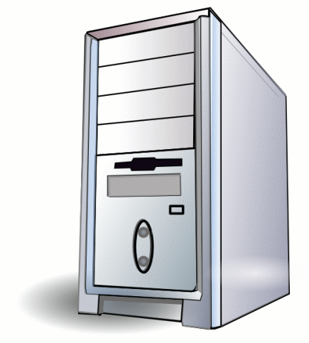



DORA - Discover
PC switched on
Sends out Discover packet
Destination
IP 255.255.255.255
MAC FF.FF.FF.FF.FF.FF
Port 67
Source
IP 0.0.0.0
MAC AB.67.87.45.C5.A1
Port 68
Broadcast IP and MAC address
UDP packet

Slide 6
DHCPDISCOVER message
UDP Src=0.0.0.0 sPort=68 Dest=255.255.255.255 dPort=67
OP | HTYPE | HLEN | HOPS
0x01 | 0x01 | 0x06 | 0x00
XID
0x3903F326
SECS |  | FLAGS
0x0000 |  | 0x0000
CIADDR (Client IP address)
0x00000000
YIADDR (Your IP address)
0x00000000
SIADDR (Server IP address)
0x00000000
GIADDR (Gateway IP address)
0x00000000
CHADDR (Client hardware address)
0x00053C04
0x8D590000
0x00000000
0x00000000
192 octets of 0s, or overflow space for additional options. BOOTP legacy
Magic cookie
0x63825363
DHCP Options
DHCP option 53: DHCP Discover
DHCP option 50: 192.168.1.100 requested
DHCP option 55: Parameter Request List:Request Subnet Mask (1), Router (3), Domain Name (15), Domain Name Server (6)
DHCPDISCOVER message

Slide 7
DORA - Offer
Offer will have a lease for a fixed time
Destination (PC)
IP 255.255.255.255
MAC AB.67.87.45.C5.A1
Port 68
Source (server)
IP 172.177.91.42
MAC F1.87.90.12.DE.5A
Port 67
The PC may actually get many offers from different DHCP servers

Slide 8
UDP Src=192.168.1.1 sPort=67 Dest=255.255.255.255 | dPort=68
OP | HTYPE | HLEN | HOPS
0x02 | 0x01 | 0x06 | 0x00
XID
0x3903F326
SECS |  | FLAGS
0x0000 |  | 0x0000
CIADDR (Client IP address)
0x00000000
YIADDR (Your IP address)
0xC0A80164
SIADDR (Server IP address)
0xC0A80101
GIADDR (Gateway IP address)
0x00000000
CHADDR (Client hardware address)
0x00053C04
0x8D590000
0x00000000
0x00000000
192 octets of 0s. BOOTP legacy
Magic cookie
0x63825363
DHCP Options
DHCP option 53: DHCP Offer
DHCP option 1: 255.255.255.0 subnet mask
DHCP option 3: 192.168.1.1 router
DHCP option 51: 86400s (1 day) IP address lease time
DHCP option 54: 192.168.1.1 DHCP server
DHCP option 6: DNS servers 9.7.10.15, 9.7.10.16, 9.7.10.18
Client offered IP address
192.168.1.100
DHCP Offer message From the Sever
Client MAC address

Slide 9
DORA - Request
192.168.1.100
DHCPREQUEST message
UDP Src=0.0.0.0 sPort=68 Dest=255.255.255.255^{[a]} dPort=67
OP | HTYPE | HLEN | HOPS
0x01 | 0x01 | 0x06 | 0x00
XID
0x3903F326
SECS |  | FLAGS
0x0000 |  | 0x0000
CIADDR (Client IP address)
0x00000000
YIADDR (Your IP address)
0x00000000
SIADDR (Server IP address)
0xC0A80101
GIADDR (Gateway IP address)
0x00000000
CHADDR (Client hardware address)
0x00053C04
0x8D590000
0x00000000
0x00000000
192 octets of 0s. BOOTP legacy
Magic cookie
0x63825363
DHCP Options
DHCP option 53: DHCP Request
DHCP option 50: 192.168.1.100 requested
DHCP option 54: 192.168.1.1 DHCP server.
Client now replies with a DHCP request, broadcast to the server, requesting the offered address.
A client can receive DHCP offers from multiple servers, but it will accept only one DHCP offer.
Based on required server identification option in the request and broadcast messaging, servers are informed whose offer the client has accepted.
When other DHCP servers receive this message, they withdraw any offers that they might have made to the client and return the offered address to the pool of available addresses.

Slide 10
DORA - Acknowledgment
The acknowledgement phase involves sending a DHCPACK packet to the client.
Packet includes
lease duration
any other configuration information that the client might have requested.
The protocol expects the DHCP client to configure its network interface with the negotiated parameters.
After the client obtains an IP address, it should probe the newly received address (e.g. with ARP Address Resolution Protocol) to prevent address conflicts caused by overlapping address pools of DHCP servers.
UDP Src=192.168.1.1 sPort=67 Dest=255.255.255.255 dPort=68
OP | HTYPE | HLEN | HOPS
0x02 | 0x01 | 0x06 | 0x00
XID
0x3903F326
SECS |  |  | FLAGS
0x0000 |  | 0x0000
CIADDR (Client IP address)
0x00000000
YIADDR (Your IP address)
0xC0A80164
SIADDR (Server IP address)
0xC0A80101
GIADDR (Gateway IP address switched by relay)
0x00000000
CHADDR (Client hardware address)
0x00053C04
0x8D590000
0x00000000
0x00000000
192 octets of 0s. BOOTP legacy
Magic cookie
0x63825363
DHCP Options
DHCP option 53: DHCP ACK (value=5) or DHCP NAK (value=6)
DHCP option 1: 255.255.255.0 subnet mask
DHCP option 3: 192.168.1.1 router
DHCP option 51: 86400s (1 day) IP address lease time
DHCP option 54: 192.168.1.1 DHCP server
DHCP option 6: DNS servers 9.7.10.15, 9.7.10.16, 9.7.10.18

Slide 11
Addresses to troubleshoot
169.254.x.x: This is what's called an Automatic Private IP address.
An IP in this range means that the computer cannot obtain an address from the DHCP server.
DHCP server is down or not repsonding
In those cases, the computer will actually give itself an IP starting with 169.254, since it must assign itself some sort of number.
Gives you basic comms to other resources with 169.254 IP addresses, but will periodically send out a DHCP request
0.0.0.0 on a client - PCs and other client devices normally show this address when not connected to a TCP/IP network. A device might give itself this address by default whenever it is offline.
It might also be automatically assigned by DHCP in the case of address assignment failures.

Slide 12
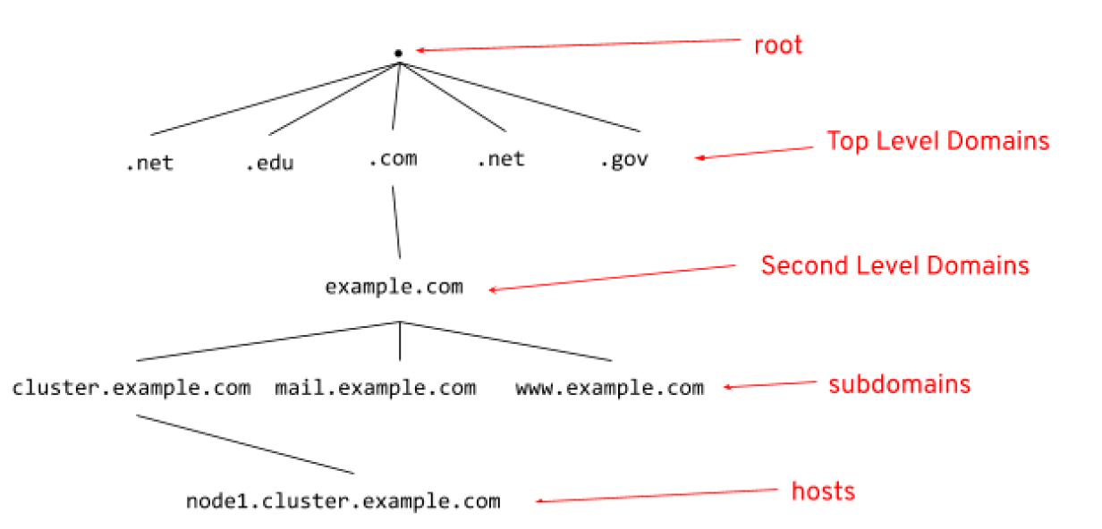
Domain Namespace System
The DNS Namespace is based on a "tree" structure, with a small number of generic Top Level Domains (eg, .com, .edu, .org) and a large number of country-based domains
(eg .au, .my, .uk). Each TLD supports a group of "second-level" domains, and so on, all the way down to individual hosts.

Slide 13
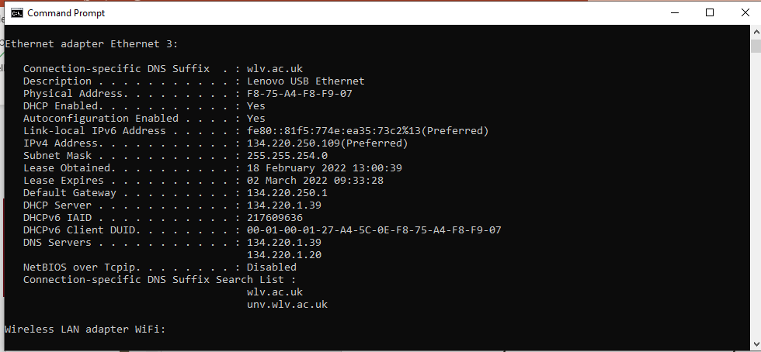
Domain Name Servers
Need to translate the web address used in a browser such as www.wlv.ac.uk into actual IP address so a request can be made to that web browser to access a web page
The DNS system is the mechanism by which this happens

Slide 14
Types of DNS resolvers
A stub resolver is a software component normally found in endpoint hosts that generates DNS queries when application programs running on desktop computers or mobile devices need to resolve DNS domain names.
Keeps a cache of recently resolved queries
The recursive resolver may reside in a home router, be hosted by an internet service provider or be provided by a third party, such as Google's Public DNS recursive resolver at 8.8.8.8 or the Cloudflare DNS service at 1.1.1.1.

Slide 15
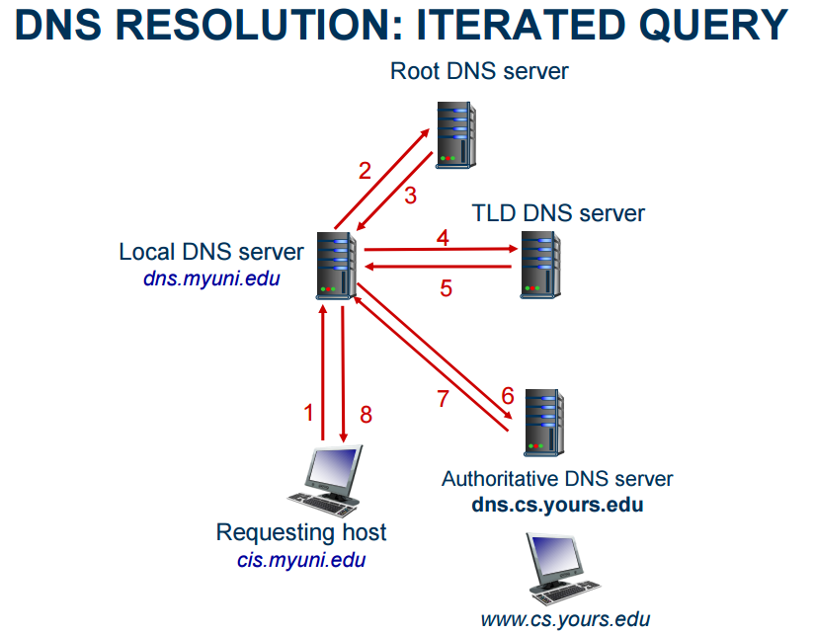
Local DNS server - “Hey, I need the IP address for this domain. Please let me know the address of the next DNS server in the lookup process so I can look it up myself.”

Slide 16
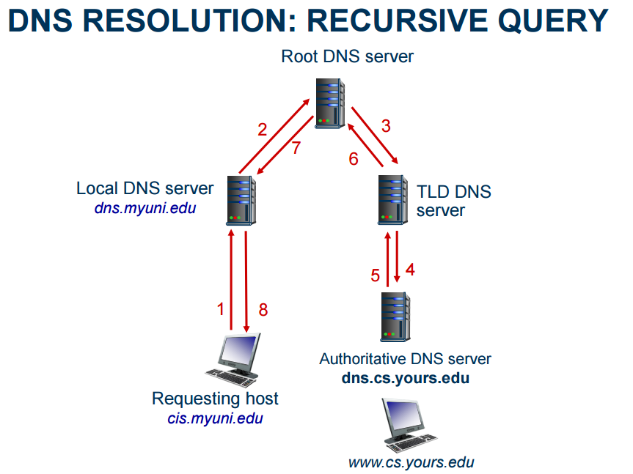
Local Dns Server - “Hey, I need the IP address for this domain, please hunt it down and don’t get back to me until you have it.”
Generally faster than iterative, but vulnerable to amplification and DNS poisoning attacks
https://www.youtube.com/watch?v=pkvaTUl5F-Y

Slide 17
DNS Caching
Caching can substantially reduce overhead – The top-level servers very rarely change – Popular sites visited often – Local DNS server often has the information cached
How DNS caching works – DNS servers cache responses to queries – Response includes a TTL field – Server deletes the cached entry after TTL expires (typically 12 hours)
DNS negative queries are cached – Save time for non-existent sites, e.g., misspelling

Slide 18
DIRECTING WEB CLIENTS TO REPLICAS
Large websites use multiple webservers - replicas
Simple approach: different names – www1.cnn.com, www2.cnn.com, www3.cnn.com – But, this requires users to select specific replicas
More elegant approach: different IP addresses – Single name (e.g., www.cnn.com), multiple addresses – E.g., 64.236.16.20, 64.236.16.52, 64.236.16.84, …
Authoritative DNS server returns many addresses – The local DNS server selects one address – Authoritative server may vary the order of addresses
Load balancing based on performance and proximity

Slide 19
Zones
A DNS zone is a distinct part of the domain namespace which is delegated to a legal entity—a person, organization or company, who are responsible for maintaining the DNS zone.
The Domain Name System (DNS) defines a domain namespace, which specifies Top Level Domains (such as “.com”), second-level domains, (such as “acme.com”) and lower-level domains, also called subdomains (such as “support.acme.com”). Each of these levels can be a DNS zone.
The name servers in their respective zones are responsible for answering queries for their zones.
There is usually one primary nameserver and one or more secondary nameservers.

Slide 20
Zone transfer
A primary server will have an administrator entering the records or receive dynamic updates
A secondary server gets a copy of all the records by a taking a copy – zone transfer
A Zone transfer will occur during any of the following scenarios:
When starting the DNS Service on the secondary DNS server.
When the refresh time expires.
When changes are saved to the Primary Zone file and there is a Notify List.
Zone Transfers are always initiated by the secondary DNS server. The primary DNS server simply answers the request for a Zone Transfer.

Slide 21
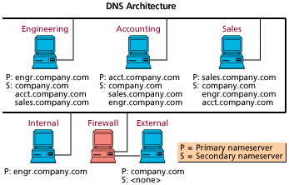
Architecture
Having local DNSs reduces traffic in network and lookup latency
Outward facing DNS advertises certain outside hosts to world – MI-Linux.wlv.ac.uk
Notes:
Once embarked on a the mission to create a DNS infrastructure, you will soon realize that you need a way to isolate certain portions of your DNS hierarchy. Not only will you want a separate DNS server external to your network with limited information, you will want servers distributed throughout your network to prevent unnecessary DNS traffic on the WAN and LAN and reduce lookup latency.
Splitting the internal and external servers will allow you to advertise certain hosts to the outside world and protect your internal hosts. A simple way to do this is by creating a hierarchy. Since you are probably already locked in to your second level domain (first level probably being .com), such as company.com, you will need to add a third level to discern departments, such as acct.company.com and engr.company.com.
Once you have a hierarchy established, you can start thinking about strategic locations for the primary servers for those subdomains. You will want to co-locate them with the bulk of the users in those departments so those users can use the server as an initial DNS contact. More than likely, they will be using mostly machines in their department and those hostnames will reside on their local DNS server.

Slide 22
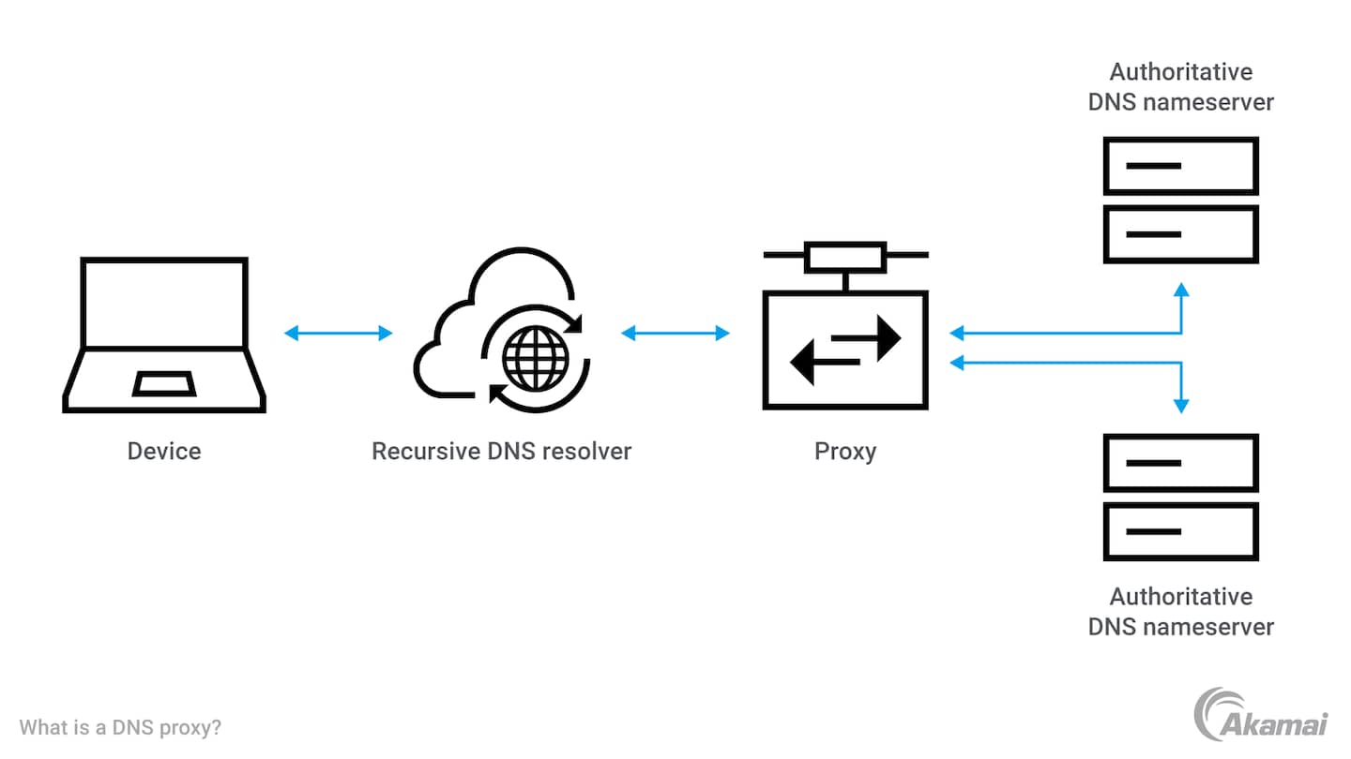
DNS proxy
Faster DNS resolution. Because it caches information about previously accessed domain names, a DNS proxy server can return results more quickly.
Less latency. By enabling name resolution from a DNS cache, DNS proxies also help reduce network latency.
Easier management. DNS proxies may help IT teams to simplify management of DNS configuration.
Stronger security. A DNS proxy may offer security features that help protect networks from cyberattacks such as domain hijacking and DNS spoofing.

Slide 23
Free and Public DNS
Public DNS servers are alternative to ones given by your ISP
Google DNS and OpenDns are the reported to be the best and most reliable
http://pcsupport.about.com/od/tipstricks/a/free-public-dns-servers.htm
These 2 most famous have geographically distributed servers with enough clusters and load balancing to reduce latency
Notes:
Latency between the client (user) and DNS resolving server. In most cases this is largely due to the usual round-trip time (RTT) constraints in networked systems: geographical distance between client and server machines; network congestion; packet loss and long retransmit delays (one second on average); overloaded servers, denial-of-service attacks and so on.
Latency between resolving servers and other nameservers. This source of latency is caused primarily by the following factors:
Cache misses. If a response cannot be served from a resolver's cache, but requires recursively querying other nameservers, the added network latency is considerable, especially if the authoritative servers are geographically remote.
Underprovisioning. If DNS resolvers are overloaded, they must queue DNS resolution requests and responses, and may begin dropping and retransmitting packets.
Malicious traffic. Even if a DNS service is overprovisioned, DoS traffic can place undue load on the servers. Similarly, Kaminsky-style attacks can involve flooding resolvers with queries that are guaranteed to bypass the cache and require outgoing requests for resolution.

Slide 24
DNS latency
Complex webpages need multiple DNS lookups – each one introduces a delay
There are two components to DNS latency:
Between client and DNS resolving server – usually due to round trip time in network etc
Between resolving servers
– cache misses require further recursive queries to other nameservers and can cause considerable latency as more authoritive nameservers may be geographically far away
Under-provissioning – if servers cannot cope they will queue or may even drop requests and require retransmissions
Malicious traffic – DNS traffic can slow down responses even they cannot overwhelm the server

Slide 25
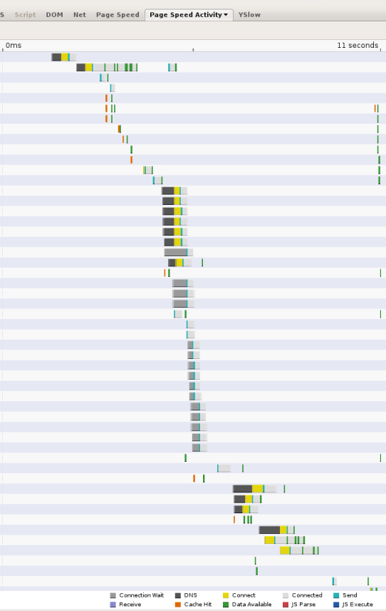
the following screen shot shows the timings reported by the Page Speed web performance measurement tool.
the black segments indicate DNS lookups
11 secs to load
13 lookups
Some in parallel
5 serial look ups

Slide 26
Weaknesses in the DNS system
DNS queries and responses may be sent over UDP, unencrypted and unsigned
eavesdropping on sensitive DNS data
queries or responses can be injected or modified, and will be treated as valid
DNS responses contain additional information
attacker may return the correct answer to a query, but include spoofed authority or additional records

Slide 27
DNS weaknesses
subverting a DNS proxy, or a DNS server near the root of the DNS tree would also be an excellent attack
DNS, like much of the Internet, is susceptible to DOS and distributed DOS
Finally, DNS allows a client to request a full zone transfer from the zone's SOA (start of authority – zones authorative DNS) server).
This allows an attacker to learn all sorts of useful information about the zone: names, IP addresses, aliases etc.
Can be mitigated by only allowing zone transfers to certain IP addresses

Slide 28
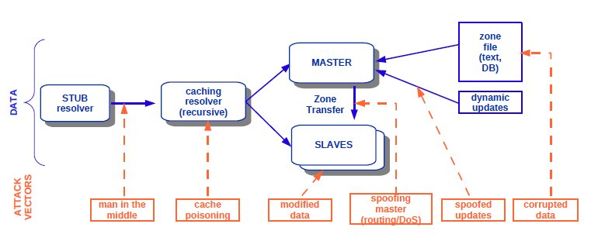
DNS security
Authorative DNS sever
Local OS on PC
DNS Db Device
Trojan horse attack will alter resolver and send you to spoof paypal etc
Spoofing of master IP address to inject false DNS entries
Overwhelm slave - believe it is receiving a dns entry from authorative server

Slide 29
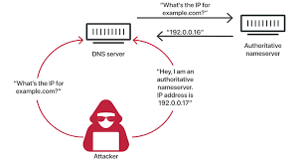
DNS poisoning attack
Without eavesdropping, an attacker can still spoof and poison a DNS server:
Attacker queries the server for a name that it doesn't know
Then attacker floods the server with faked responses with authoritative data for that name.
Attacker has to guess the transaction ID for the response to be valid, but with only 32 bits, this is quickly done in 64K responses.

Slide 30
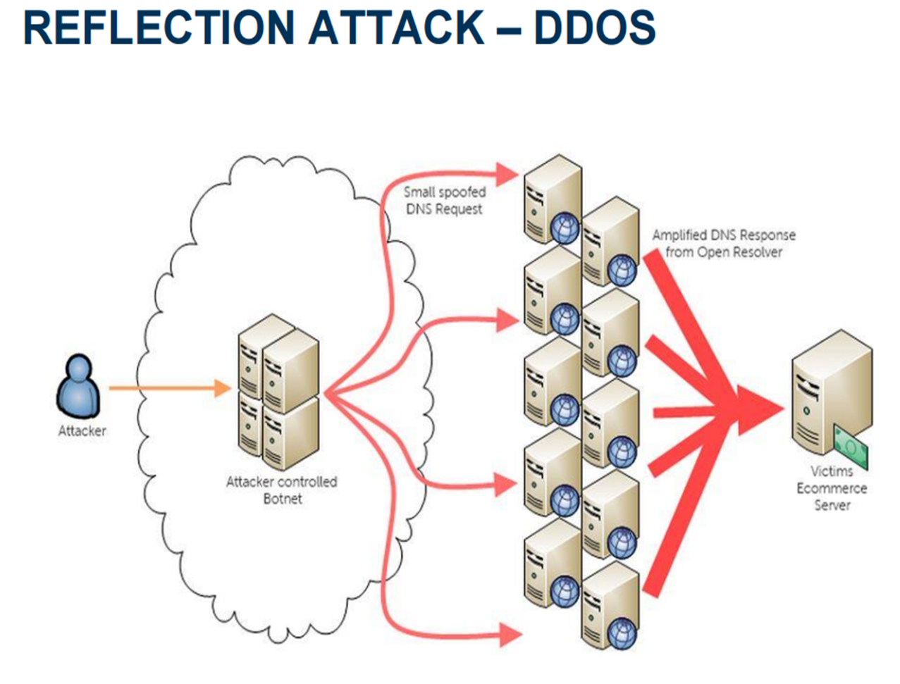
REFLECTION ATTACK
Attacker sends packets to a known service on the intermediary with a spoofed source address of the actual target system
When intermediary responds, the response is sent to the target
“Reflects” the attack off the intermediary (reflector)
Goal is to generate enough volumes of packets to flood the link to the target system without alerting the intermediary

Slide 31
Amplification attack
Variation of the reflection attack
Use packet(s) directed at a legitimate DNS server as the intermediary system – a vulnerable DNS may allow a zone transfer
Exploit DNS behaviour to convert a small request to a much larger response (amplification) – 60 bytes query
512 bytes answer (8.5x) – RFC 2671 allows larger answers
Answers larger than 4000 bytes possible (>60x)
Target is flooded with amplified response(s)

Slide 32
DNSSEC
Guarantees – Authenticity of DNS answer origin – Integrity of reply
Accomplishes this by signing DNS replies at each step of the way
Uses public-key cryptography to sign responses
DNSSEC does not provide – Confidentiality
https://www.youtube.com/watch?v=Fk2oejzgSVQ&t=114s

